Slide 1
System Programming Chapter # 3: Working with Files Lecture # 9 Week # 5 Dr. Muhammad Bilal Qureshi m.qureshi@centralasian.uz
Central Asian University, Tashkent, UZ

Slide 2
Source
Chapter # 3, Beginning Linux Programming by Neil Matthew and Richard Stones

Slide 3
Contents of chapter include
Files and devices
System calls
Library functions
Low-level file access
Managing files
The standard I/O library
Formatted input and output
File and directory maintenance
Scanning directories
Errors

Slide 4
Working with files
How to manipulate files and directories
i.e. how to create files, open them, read, write and close them.
How programs can manipulate directories (to create, scan and delete example).
How linux handles file I/O, the concept associated with files, directories and devices.
To manipulate files and directories we need to make system calls (program request service from OS kernel) which is parallel of windows API.
There exists a whole range of library functions, the standard I/O library (stdio) to make file handling more efficient.
Notes:
Application programming interface
A system call is a mechanism by which a program requests a service from the operating system's kernel. It's a fundamental interface between applications and the kernel, allowing user-level processes to perform tasks that require privileged access or access to system resources.
both system programs and normal C programs can be written in C and may use similar programming techniques, they differ in their intended purpose and scope within the computing environment. System programs focus on system management and resource administration, while normal C programs serve user-oriented tasks and problem-solving requirements.

Slide 5
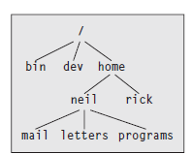
Linux File Structure
Files
In Linux system, almost everything is treated like a file.
All input and output are done by reading or writing files, because all peripheral devices, even keyboard and screen are files in the file system.
This means that a single homogeneous interface handles all communication between a program and peripheral devices.
So, we can use five basic functions: open, close, read, write, and ioctl for disk files, serial ports, sockets, printers, etc.
Directories are also a special sort of files.
Notes:
The /home directory is itself a subdirectory of the root directory, /, which sits at the top of the hierarchy and contains all of the system’s files in subdirectories. The root directory normally includes /bin for
system programs (“binaries”), /etc for system configuration files, and /lib for system libraries.
Files
that represent physical devices and provide the interface to those devices are conventionally found in a directory called /dev.

Slide 6
Linux File Structure
Every Directory or a file has a name and some properties like creation date, user permissions, size of the file, and its location on the disk.
All these properties are stored against the file’s inode number (this no. is unique only with in a disk partition).
A system uses a file’s inode number, while the directory structure names that file for our benefit.
A directory is a file that holds the inode numbers and names of other files. Removing the filename also removes the inode number from the directory.
To see the inode number type this command $ls –i or ls -li
Using ln –s hello.c soft.c command you can make soft link to the same file/directory in different directories.
Using ln hello.c hard.c you can make hard links to the same file in different directories on the same partition.
Notes:
touch helo.c
ln –s hello.c soft.c
ln hello.c hard.c
Hardlink is like creating another name for the inode.

Slide 7
Linux File Structure
Hard link is not allowed for a directory.
Hard links have the same inode number as the original file.
Symbolic (Soft) links (they are like shortcuts in Windows) have their own unique inode number.
You can’t create a hard link to a file on a different partition but you can create a soft link on a different partition.
ls –l command also indicates the type of file,
The first hyphen (-) symbol indicates a regular file
l indicates a Soft Link, d indicates a Directory
p Indicates a FIFO or a Pipe (Inter Process Communication)
s Indicates a Unix Domain Socket.
c Indicates a Character Device (such as a terminal),
b Indicates a Block Device (such as a hard disk).
Type this command to see these files ls –l /dev | less
Notes:
ls –l /dev | grep brw (block devices)
ls -l /dev | grep ^b
ls –al /dev | less
ls –l /dev | grep crw (character devices)
b to move back
Major number (type of device driver needed to access that device) and minor number (differentiate bw individual devices of same type)
Less is a pager program to output onepage at a time
FIFO n pipe both used for inter process communication

Slide 8
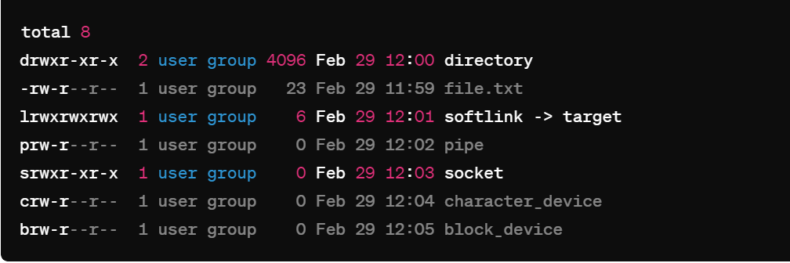
A sample output of ls -l

Slide 9
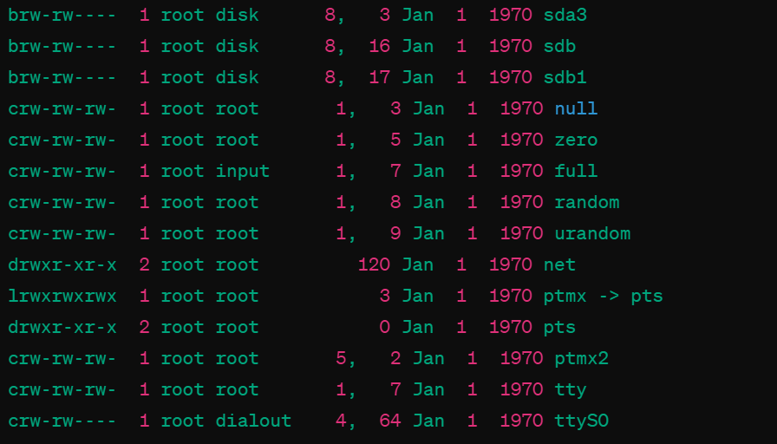
ls –l /dev output

Slide 10
Files and Devices
To mount IDE cdrom type following command
# mount –t iso9660 /dev/cdrom /mnt/cdrom
# cd /home/cdrom
To mount .iso file type following command
# mount –t iso9660 –o loop /home/file.iso /mnt/cdrom1
# cd /home/cdrom1
To mount a FAT32 partition
# mount -t vfat /dev/hda1 /mnt/winfiles
To mount a NTFS partition
# mount -t ntfs /dev/hda4 /mnt/myntfs
To unmount use # umount /mnt/cdrom
To open cdrom # eject –v To close #eject -t
Notes:
-o loop is used to access regular file as if it were a block device
Iso9600 file system for cd
Accessing device at somepoint like /home/cdrom -t to specify the file system Integrated Drive Electronics

Slide 11
Device file in Linux
Three important device files in Linux are
/dev/console
This device represents the system console (screen). Error messages and diagnostics are often sent to this device.
/dev/tty
This device is used as virtual terminal for the user.
There’s only one /dev/console device, there are many different terminals like tty1(first virtual terminal), tty2 etc.
3. /dev/null
This file is the null device. All output written to this device is discarded e.g.
$ echo do not want to see this > /dev/null
$ cp /dev/null empty_file (alternate of touch)
$ echo do not want to see this >> msg.txt
Notes:
The text will be appended with msg.txt
Tty aka teletypewriter

Slide 12
System calls and Device Drivers
We can access and control files and devices using small number of functions.
These functions known as system calls are provided by Unix (and Linux) directly and are interface to OS itself.
At the heart of OS, the kernel, are number of device drivers. These are a collection of low-level interfaces for controlling system hardware.
For example, a device driver for a tape drive which knows how to start the tape, wind it forward and backward, read and write to it and so on. It also knows tapes must be written to in blocks of certain size. Because tapes are sequential the driver can’t access tape block directly but must wind the tape to right place.

Slide 13
System calls and Device Drivers (Cont..)
Similarly, a low-level hard disk device driver will only write whole numbers of disk sectors at a time but will be able to access any desired disk block directly, because the disk in a random-access device.
To provide similar interface, device drivers encapsulate all the hardware dependent features.
Device files in /dev are used in the same way; they can be opened, read, written, and closed. For example, the same open call used to access a regular file is used to access a user terminal, a printer or a tape drive.
The low-level functions used to access the device drivers, the system calls, include:
❑ open: Open a file or device
❑ read: Read from an open file or device
❑ write: Write to a file or device
❑ close: Close the file or device
❑ ioctl: Pass control information to a device driver
Notes:
Whole Sector Writes: Hard disk hardware is designed to read or write data in fixed-size units called sectors. A sector is the smallest addressable block on the disk. Even if you want to write only a small part of a sector, the driver must write the entire sector. This is why a low-level device driver only writes whole sectors at a time.
Random Access Capability: Unlike sequential access devices (like tape drives), hard disks allow you to directly access any disk block (or sector) regardless of its position on the disk. This means the driver can go directly to the location of any desired disk block without needing to read through other sectors first. The term "random access" emphasizes that the disk's design enables quick jumps to any sector, making data retrieval efficient.

Slide 14
System calls and Device Drivers
The ioctl system call is used to provide some necessary hardware-specific control (as opposed to regular input and output), so its use varies from device to device.
For example, a call to ioctl can be used to rewind a tape drive or set the flow control characteristics of a serial port. For this reason, ioctl isn’t necessarily portable from machine to machine. In addition, each driver defines its own set of ioctl commands.
These and other system calls are usually documented in section 2 of the manual pages. Prototypes providing the parameter lists and function return types for system calls, and associated #defines of constants, are provided in include files.

Slide 15
Library functions
The problem with using low-level system calls directly for input and output is that they can be very inefficient. Why?
There’s a performance penalty in making a system call. System calls are therefore expensive compared to function calls because Linux has to switch from running your program code to executing its own kernel code and back again..
The hardware has limitations that can impose restrictions on the size of data blocks that can be read or written by the low-level system call at any one time.
To provide a higher-level interface to devices and disk files, a Linux distribution, like UNIX, provides a number of standard libraries. These are collections of functions that you can include in your own programs to handle these problems. A good example is the standard I/O library that provides buffered output. You can effectively write data blocks of varying sizes, and the library functions arrange for the low-level system calls to be provided with full blocks as the data is made available.

Slide 16
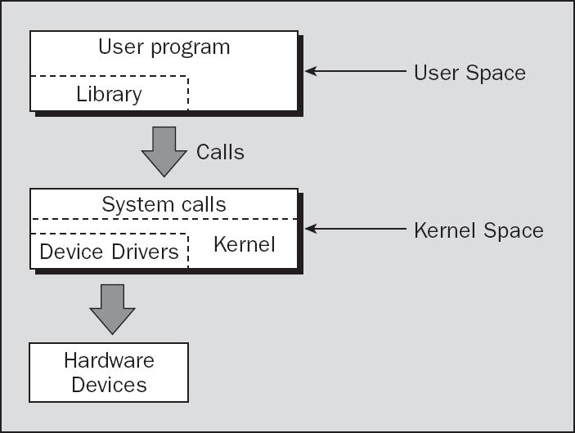
Linux System
A hierarchy view of Unix system, where various file functions exist in user space and kernel space in the different levels to complete different jobs.

Slide 17
Linux System
System calls
The Linux system provides its service through a set of functions called as system calls. open, read, write, close, ioctl are the examples of system calls.
Device drivers
The Kernel uses device drivers to interact with the hardware. Device drivers are placed at /dev location.
Library functions
To provide a higher level interface to devices and disk files, Linux provides a number of standard libraries, e.g.
< stdio.h >; < time.h >; < stdlib.h >; < math.h >, etc.
Using Library functions, we can avoid the penalty in making system calls.
Notes:
The ioctl system call (short for input/output control) is a mechanism in Unix-like operating systems (including Linux) that allows processes to communicate with and control hardware devices, sockets, and other low-level interfaces that do not necessarily fit into the standard file-oriented read/write interface.

Slide 18
Low-Level File Access
Each running program, called a process, has a number of file descriptors associated with it. These are small integers that you can use to access open files or devices.
What is file descriptor?
If you read and write a file, the system will check:
Does this file exist?
Do you have permission to access it?
If all is well, it will return to the program a small non-negative integer, and this is a file descriptor.
When a program starts, it usually has three of these descriptors already opened. These are:
0: Standard input
1: Standard output
2: Standard error

Slide 19
Low-Level File Access
You can associate other file descriptors with files and devices by using the open system call.
write
#include <unistd.h>
size_t write(int fildes, const void *buf,
size_t nbytes);
The write system call arranges for the first nbytes bytes from buf to be written to the file associated with the file descriptor fildes.
It returns the number of bytes actually written. If the function returns 0, it means no data was written.
if it returns –1, there has been an error in the write call, and the error will be specified in the errno global variable.
Notes:
Size_t is an unsigned integer to represent the size of object
buf as a pointer that points to constant memory of an unspecified type. This is commonly used when you want to pass a pointer to a function but don't want the function to modify the data that buf points to.

Slide 20
Low-Level File Access
Now write your first program
simple_write.c
#include <unistd.h>
#include <stdlib.h>
int main(){
if ((write(1, "Here is some data\n", 18)) != 18)
write(2, "A write error has occurred on file
descriptor 1 \n",46);
exit(0);
}
This program simply prints a message to the standard output. When a program exits, all open file descriptors are automatically closed, so you don’t need to close them explicitly.
This won’t be the case, however, when you’re dealing with buffered output.
Now replace the code != with == and run the program again
Notes:
Purpose: write is a system call provided by the operating system that is used to write data to a file descriptor.
Usage: It is typically used for low-level I/O operations to write data directly to files, sockets, or other output streams.
Features: write operates at a lower level than printf and does not support formatting. It writes raw data bytes to the specified file descriptor.

Slide 21
Low-Level File Access
read
#include <unistd.h>
size_t read(int fildes, void *buf, size_t nbytes);
The read system call reads up to nbytes bytes of data from the file associated with the file descriptor fildes and places them in the data area buf.
It returns the number of data bytes actually read, which may be less than the number requested.
If a read call returns 0, it had nothing to read; it reached the end of the file. Again, an error on the call will cause it to return –1.
The Next program, simple_read.c, copies the first 128 bytes of the standard input to the standard output. It copies all of the even input if there are fewer than 128 bytes.

Slide 22
Low-Level File Access
simple_read.c
#include <unistd.h>
#include <stdlib.h>
int main(){
char buffer[128];
int nread;
nread = read(0, buffer, 128);
if (nread == -1)
write(2, "A read error has occurred\n", 26);
if ((write(1,buffer,nread)) != nread)
write(2, "A write error has occurred\n",27);
exit(0);
}
create some input for the program using echo, which is piped to your program. $ echo hello there | ./simple_read
Redirect input from a file. Now first part of the file draft1.txt is appearing on the standard output.
$ ./simple_read < draft1.txt

Slide 23
Task
Write a C program that uses the open system call to open a file named "sample.txt" in read-only mode. Ensure that the program prints an appropriate error message if the file doesn't exist or if there's an error opening the file. Use stdio function perror instead of printf, and experience what’s the advantage of it. (file opening is must before read or writing into it)

Slide 24
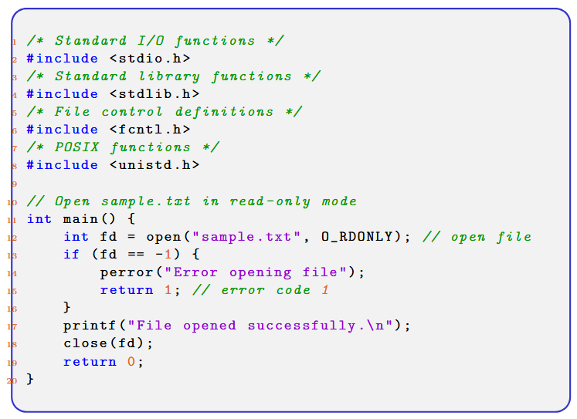
Cont()..

Slide 25
Thank You
Questions?

